Slide 1
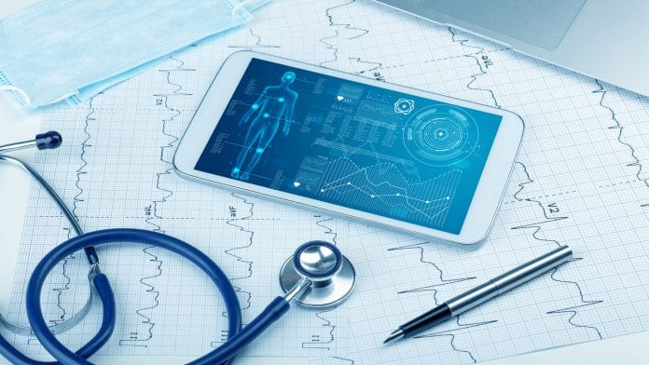
My Vac App
Created by: Shelby Lovejoy, Erin O’Sullivan, and Meredith Hazzard

Slide 2
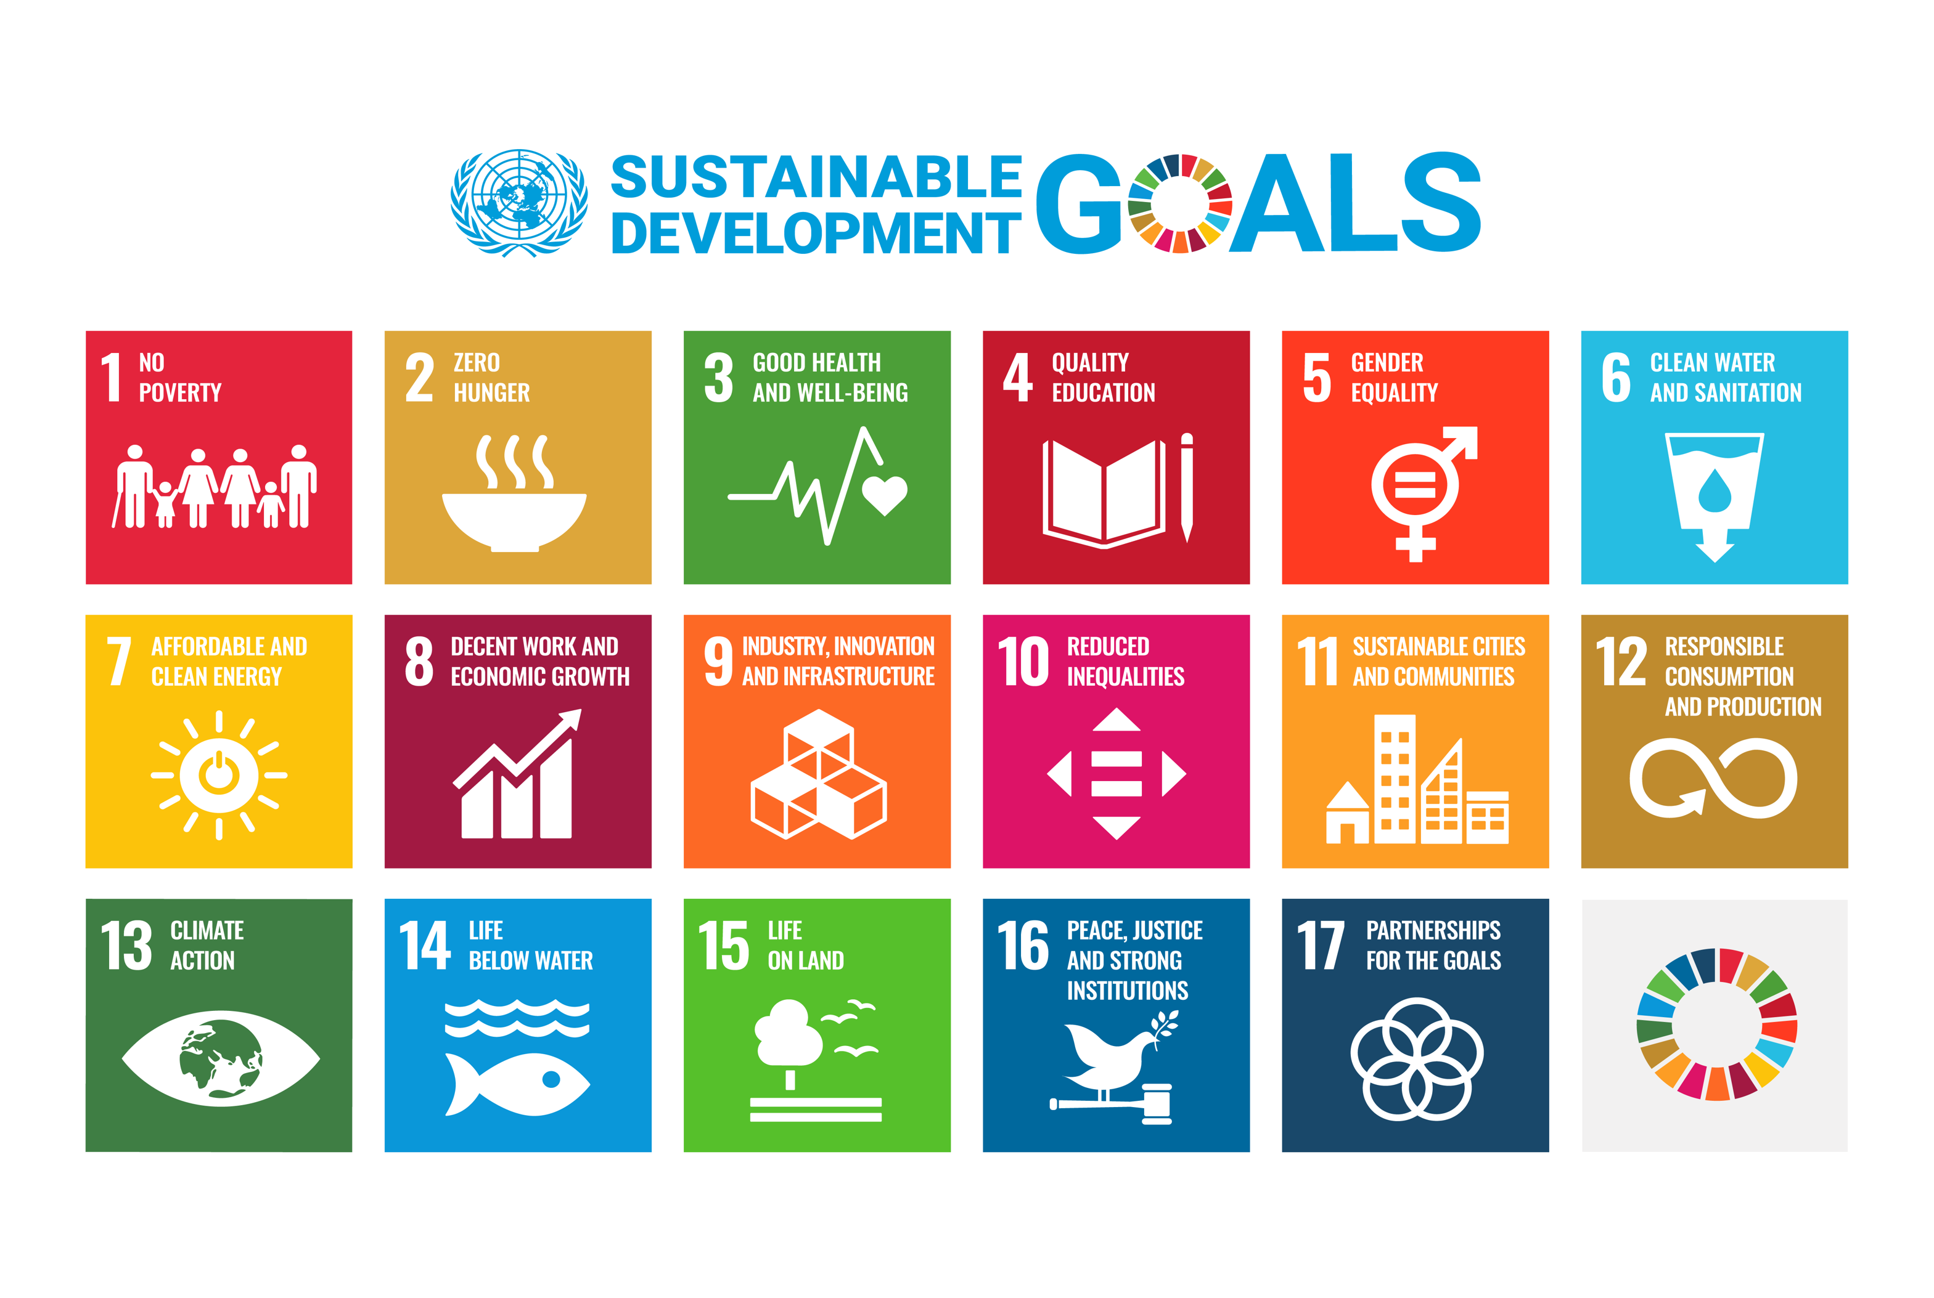
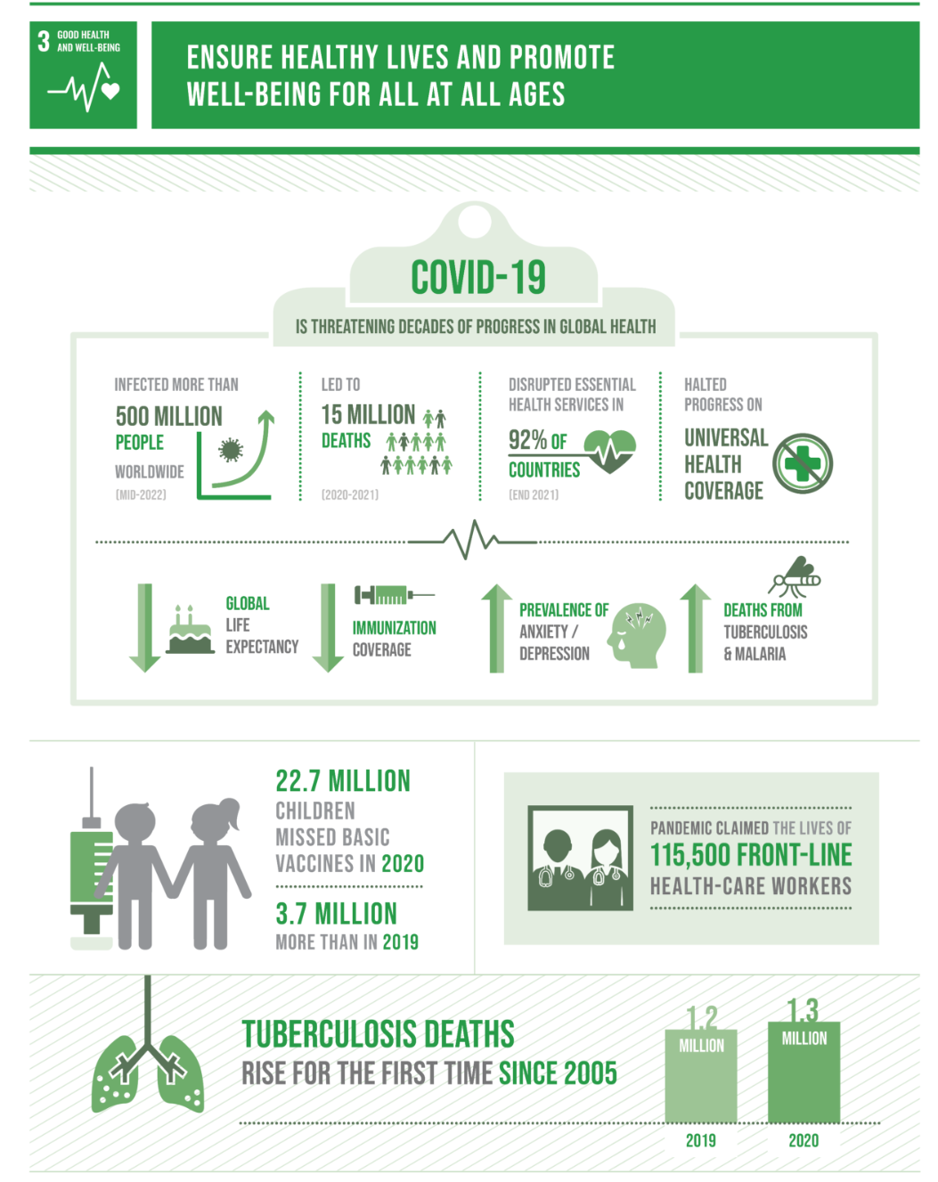
United Nation’s 17 Sustainability Goals
17 Goals established as an urgent call for action by all countries in order to form a global partnership that addresses improving health and education, reducing inequalities, preserving our environment, ending poverty, and economic growth.

Slide 3






Quick Vac Stats
23 million children
Only13% of girls
3.5 million children
79% Increase
$1.90 per day
Went unvaccinated for basic vaccines in 2020, with an estimated 17 million receiving zero vaccination
Were vaccinated against HPV in 2020
Missed their first dose of diphtheria, tetanus, and pertussis vaccines and have also missed out on other vaccinations such as those for polio and measles
In measles cases during the first two months of 2022
How much money zero-dose children, kids who have received no vaccination at all, and their families survive on each day

Slide 4



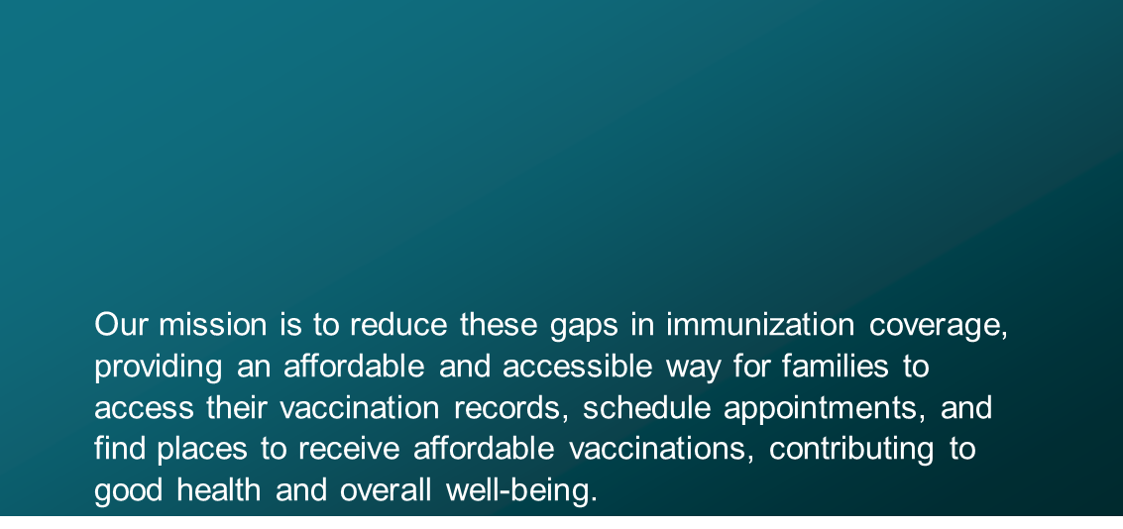
Our big idea

Slide 5
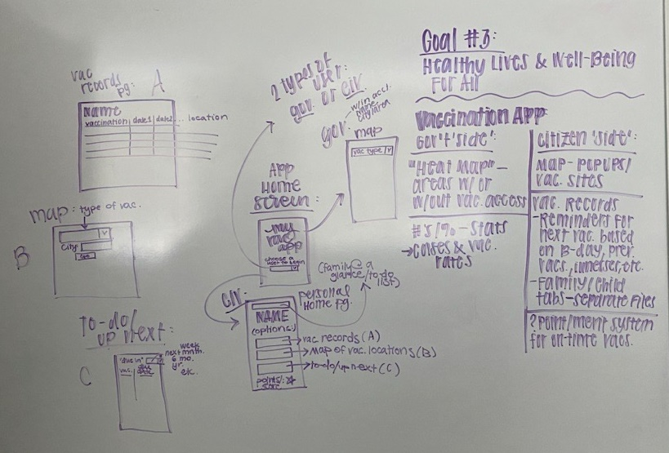
Brainstorming

Slide 6
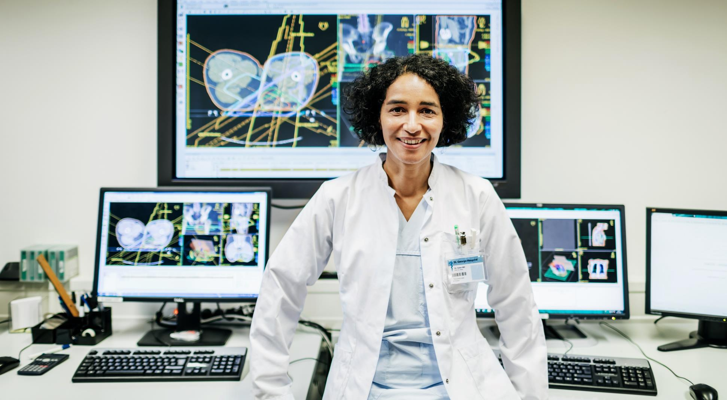
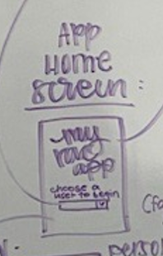
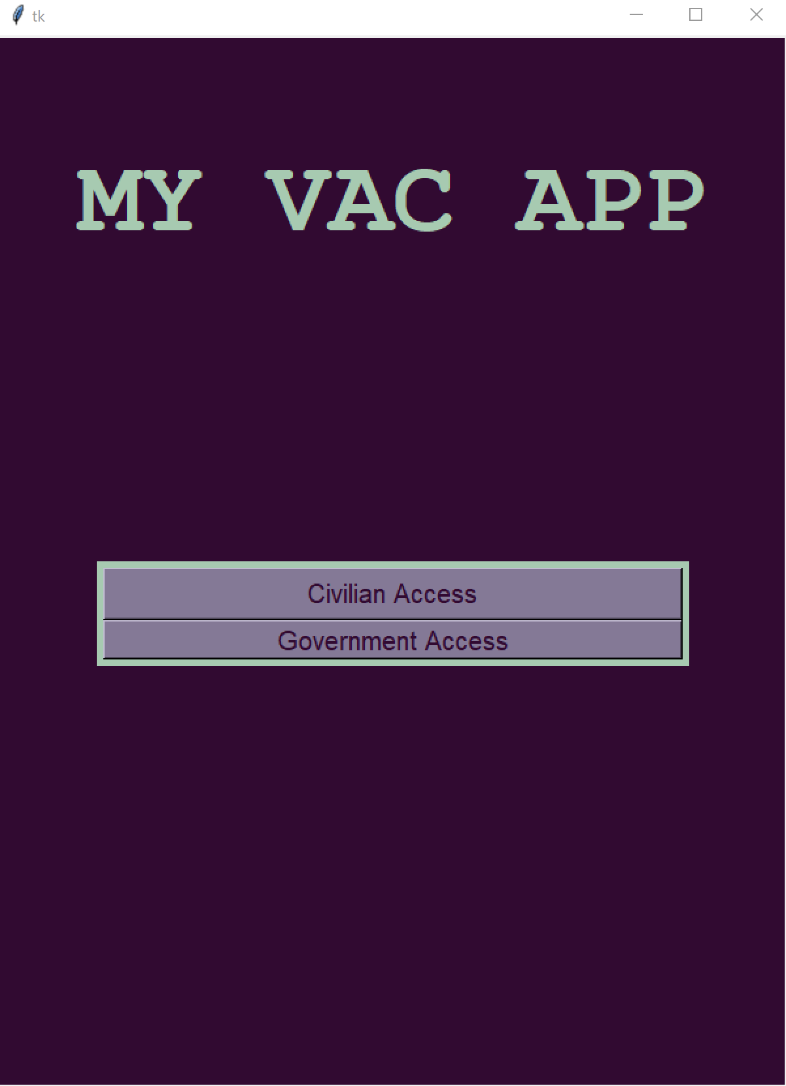
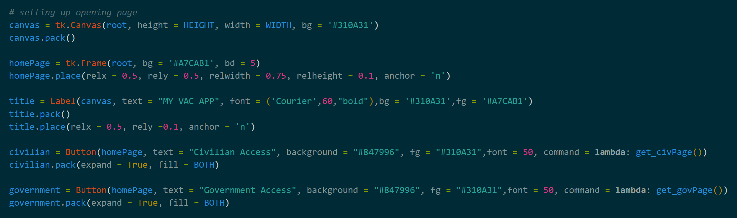
How it works

Slide 7

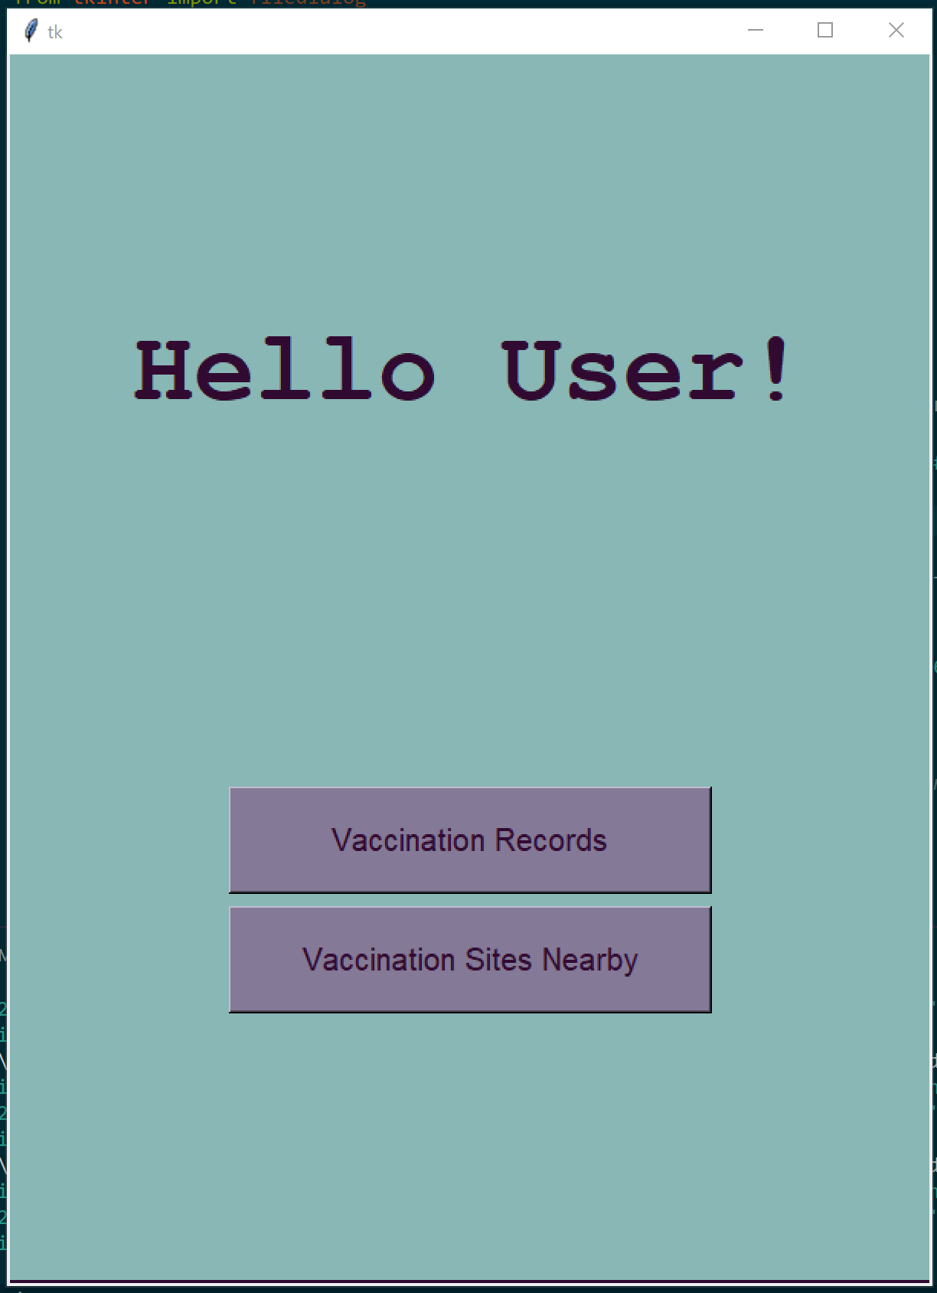
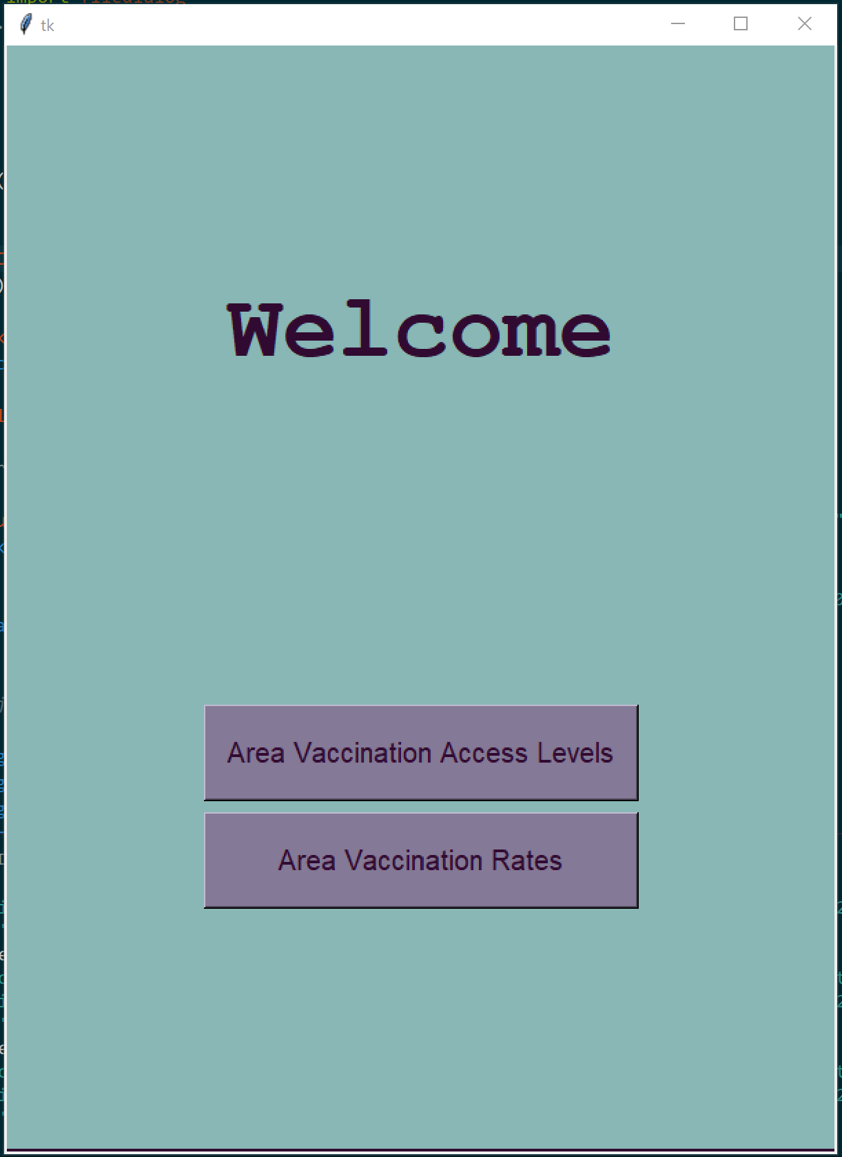
Different users
CIVILIAN government

Slide 8
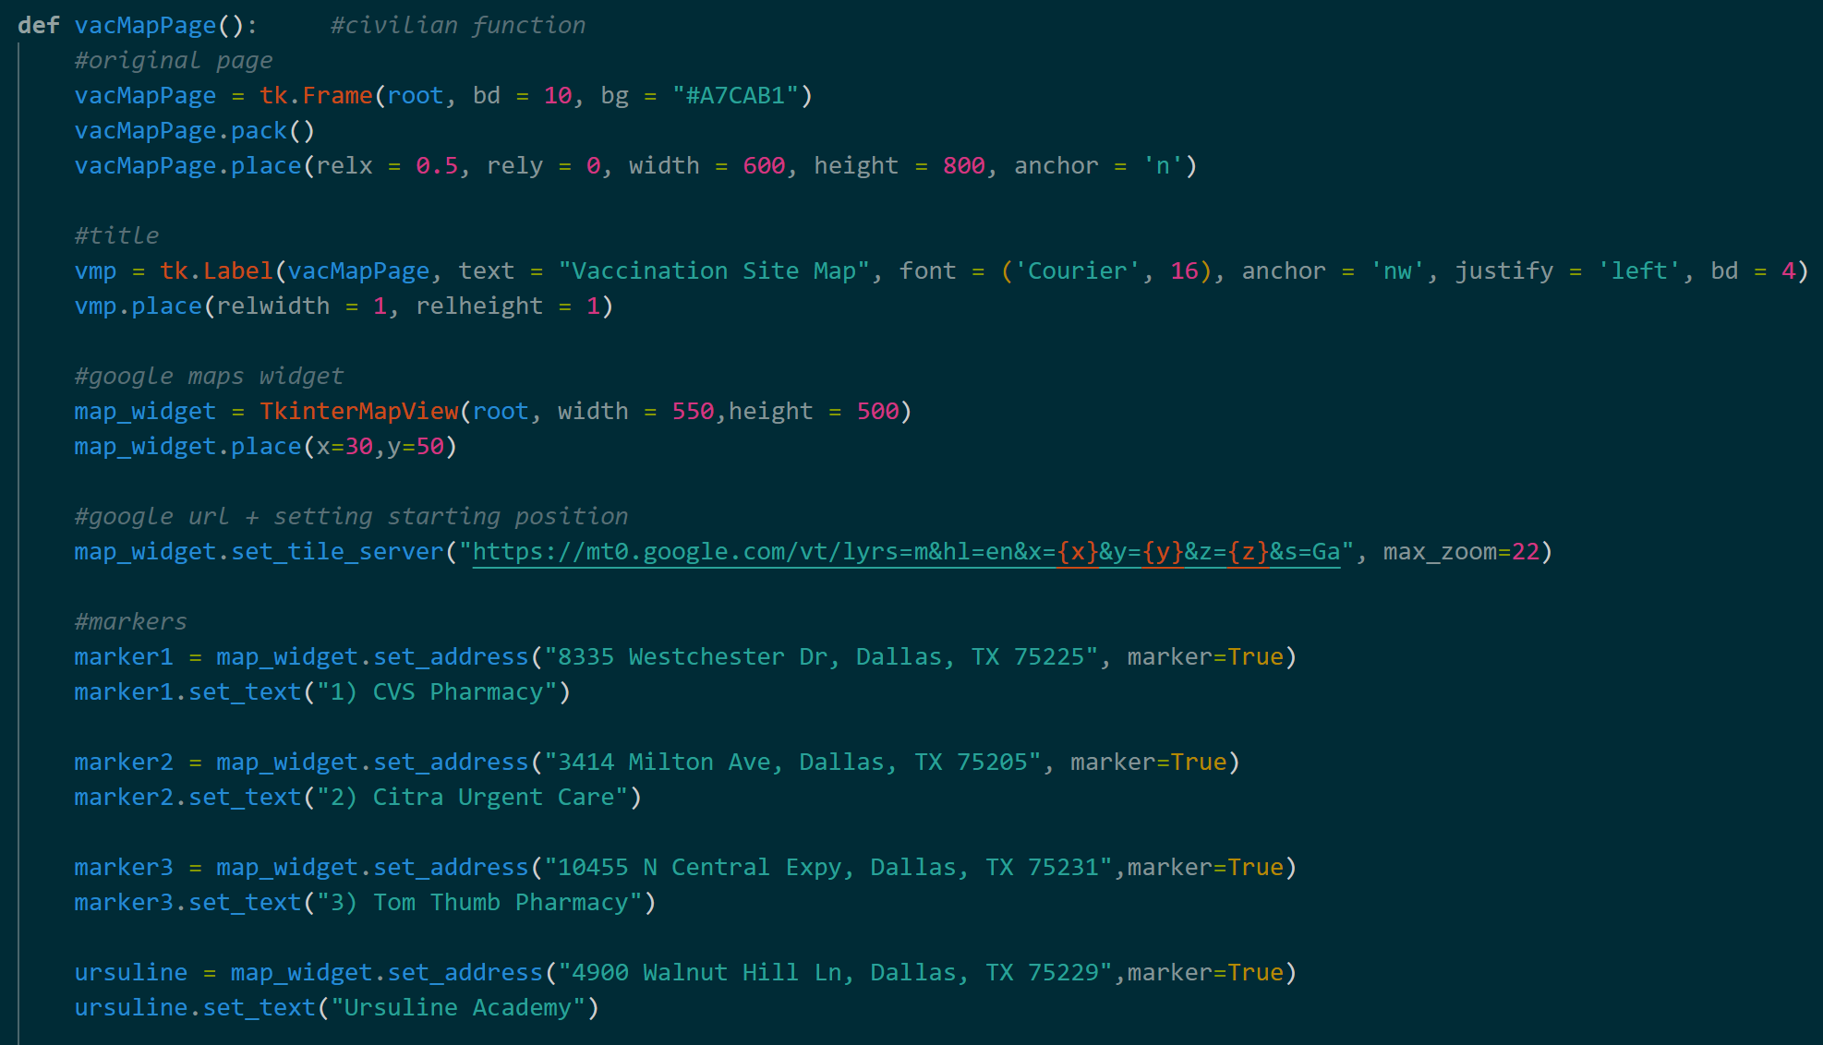
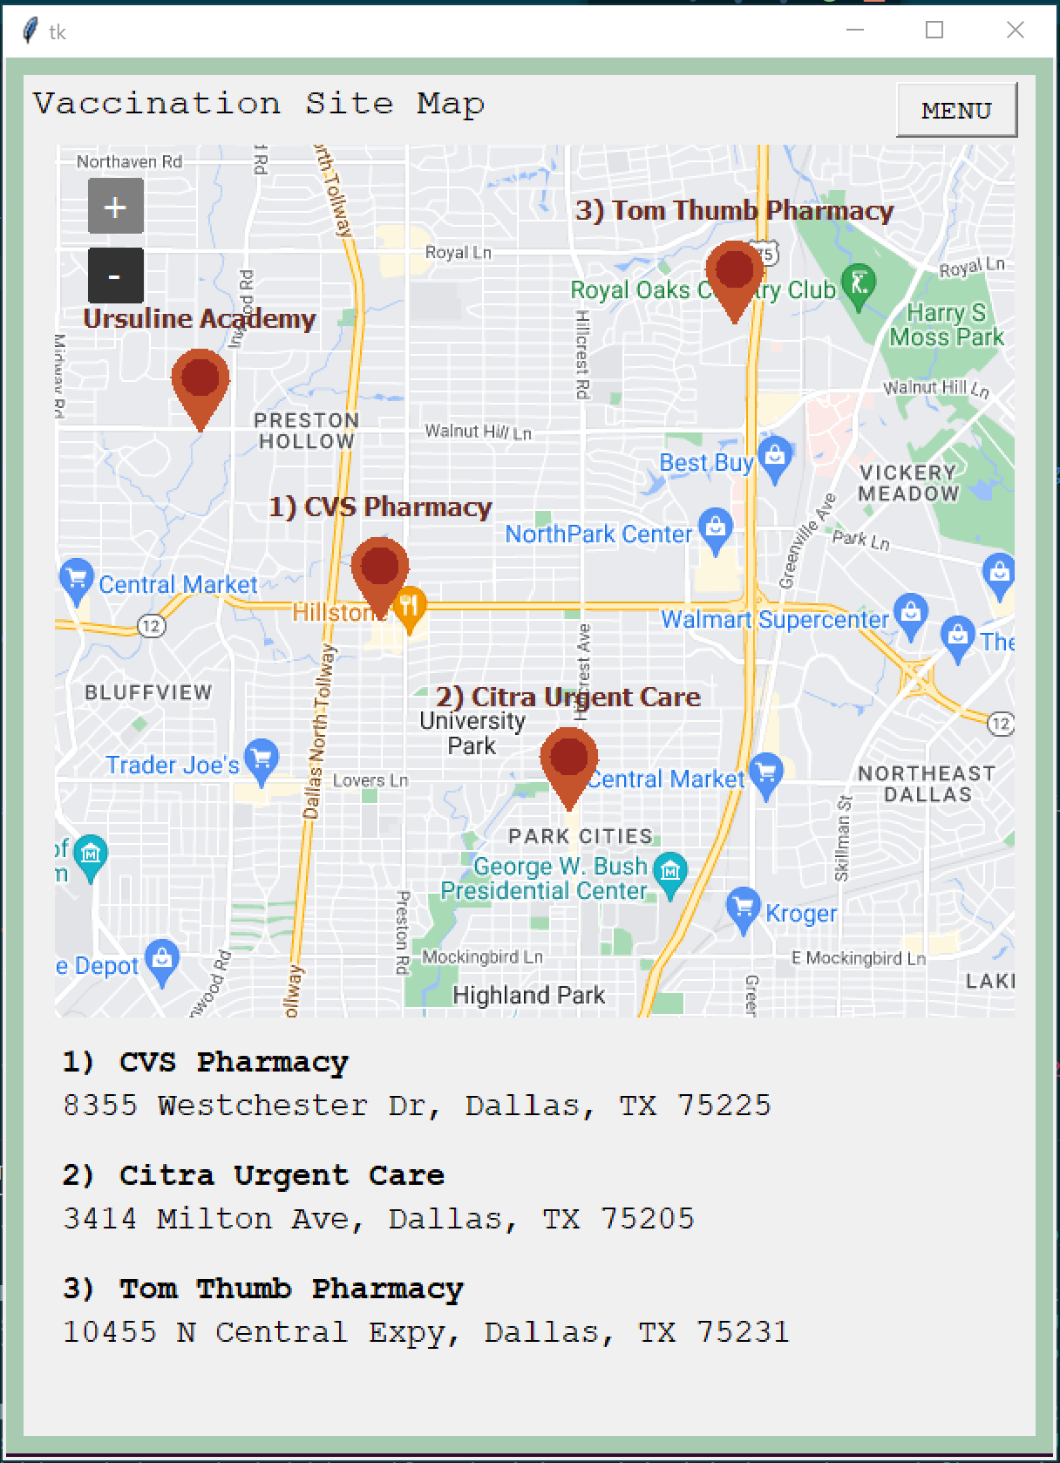
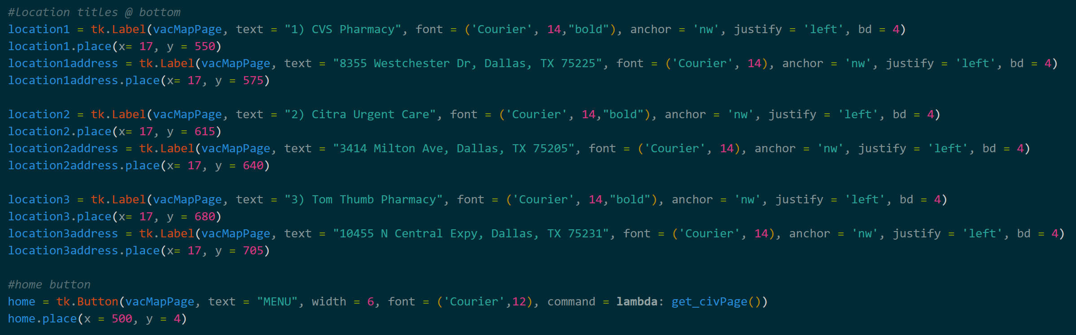
CIVILIAN – VACCINATION SITE MAP

Slide 9
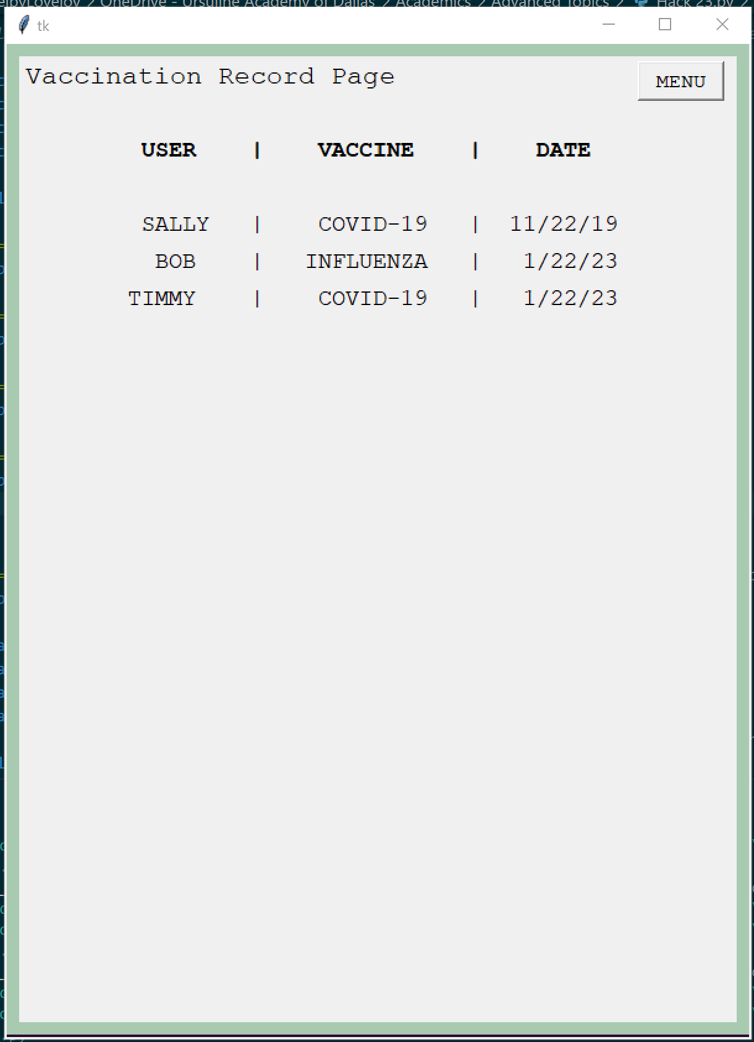
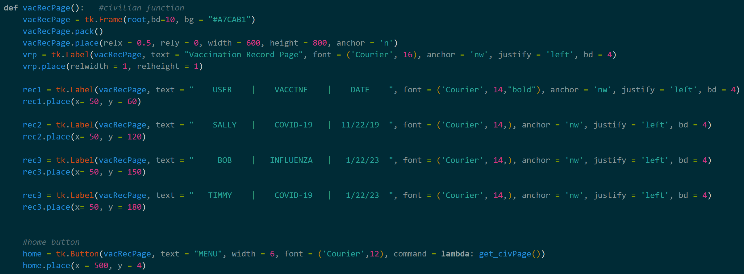
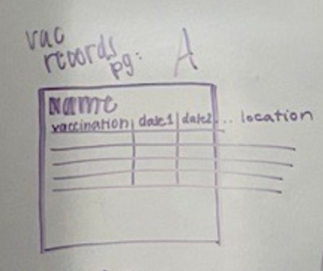
CIVILIAN – records page

Slide 10
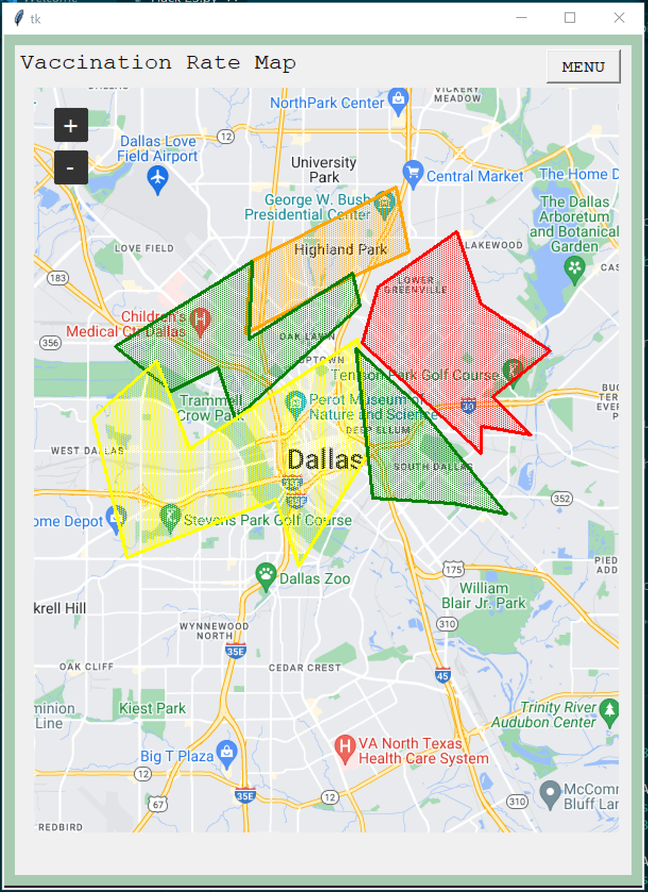
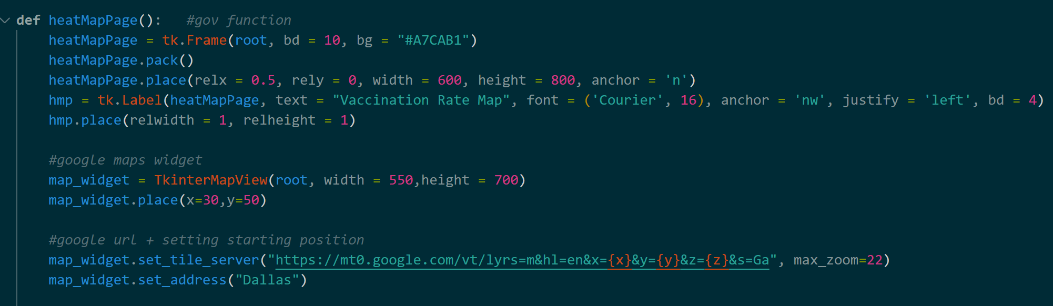
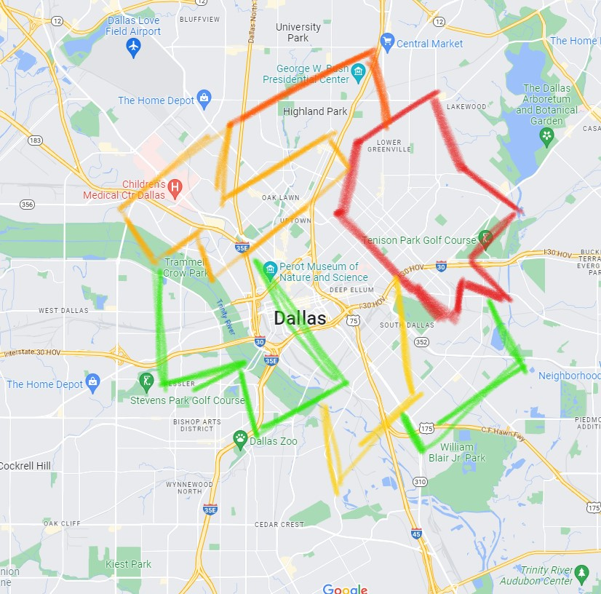
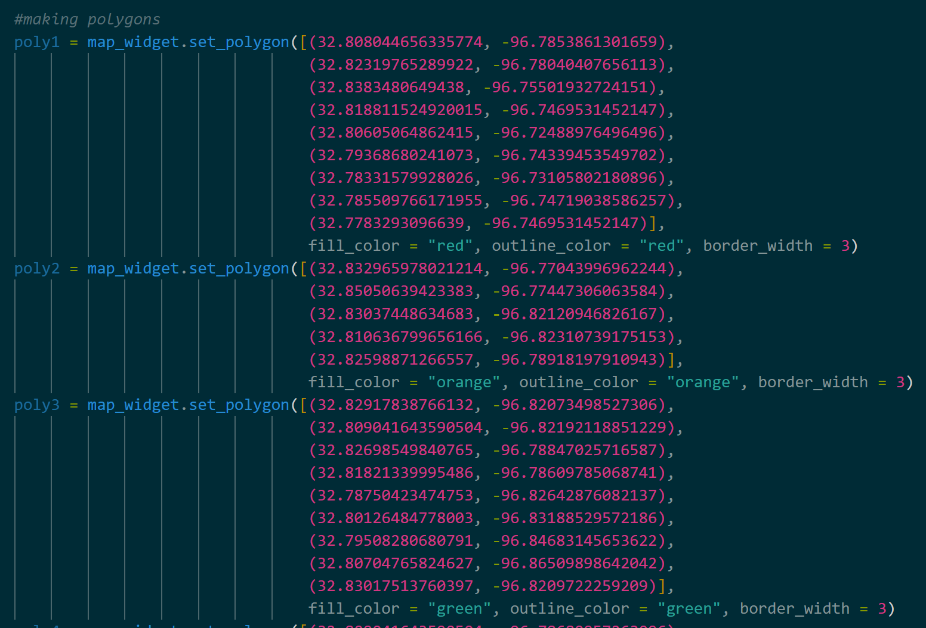
GOVERNMENT – VACCINATION RATES map

Slide 11
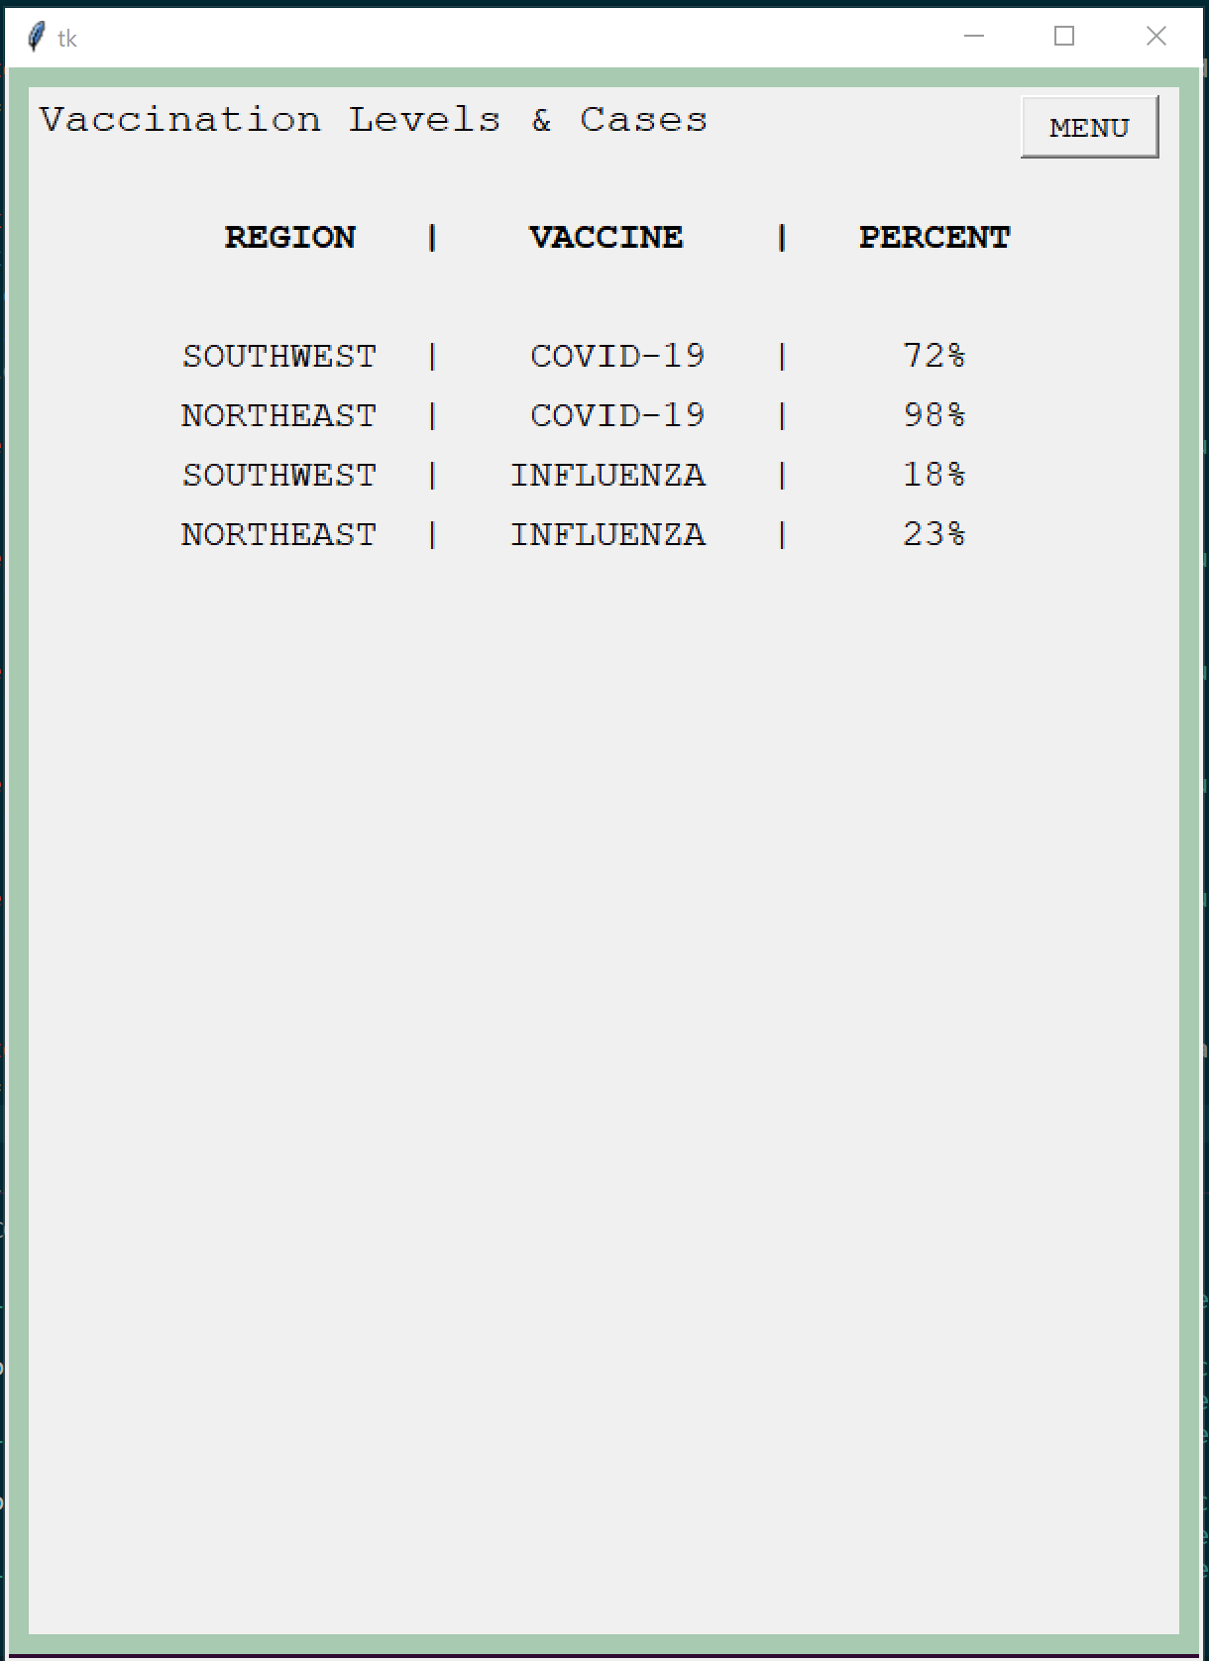
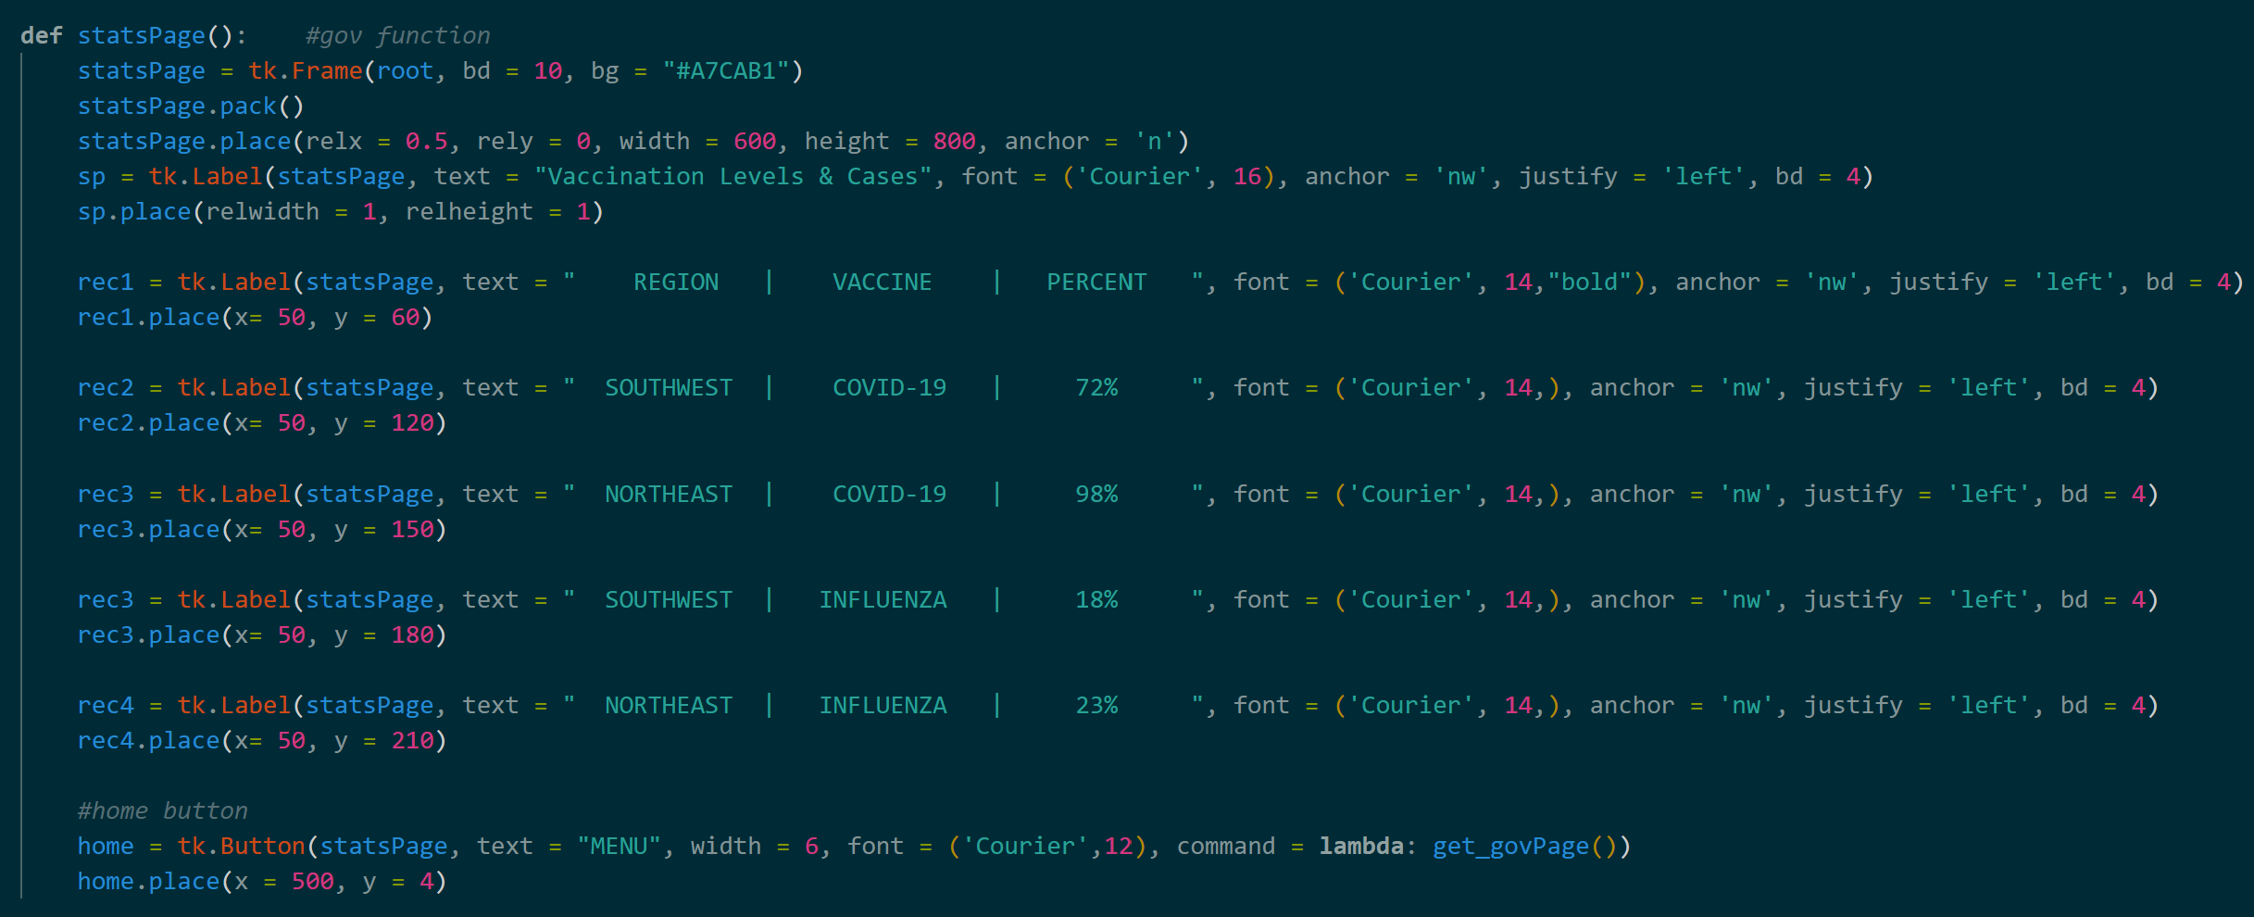
GOVERNMENT – VACCINATION RATES DATA

Slide 12
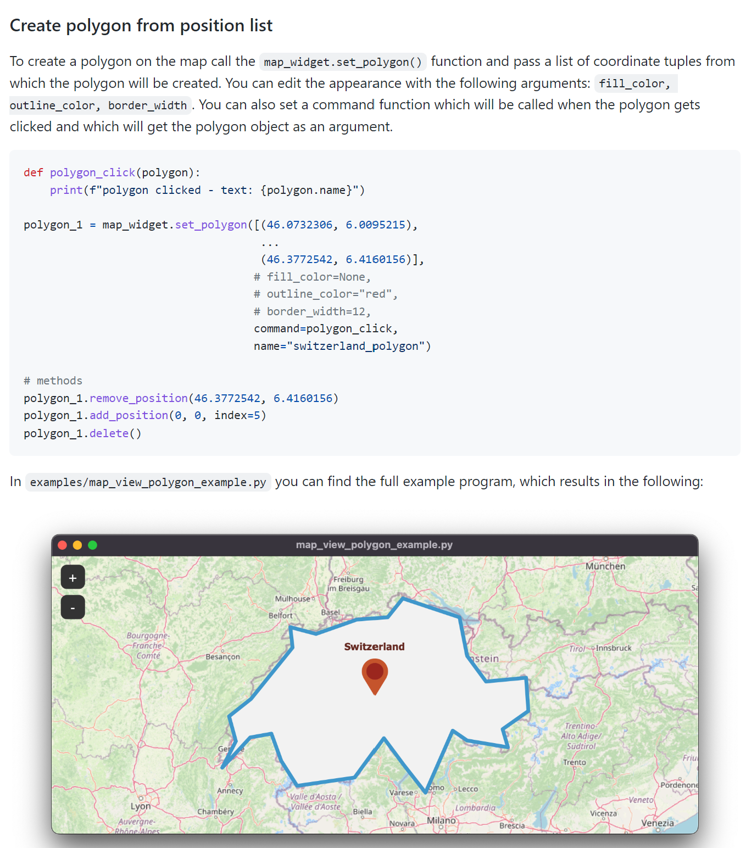
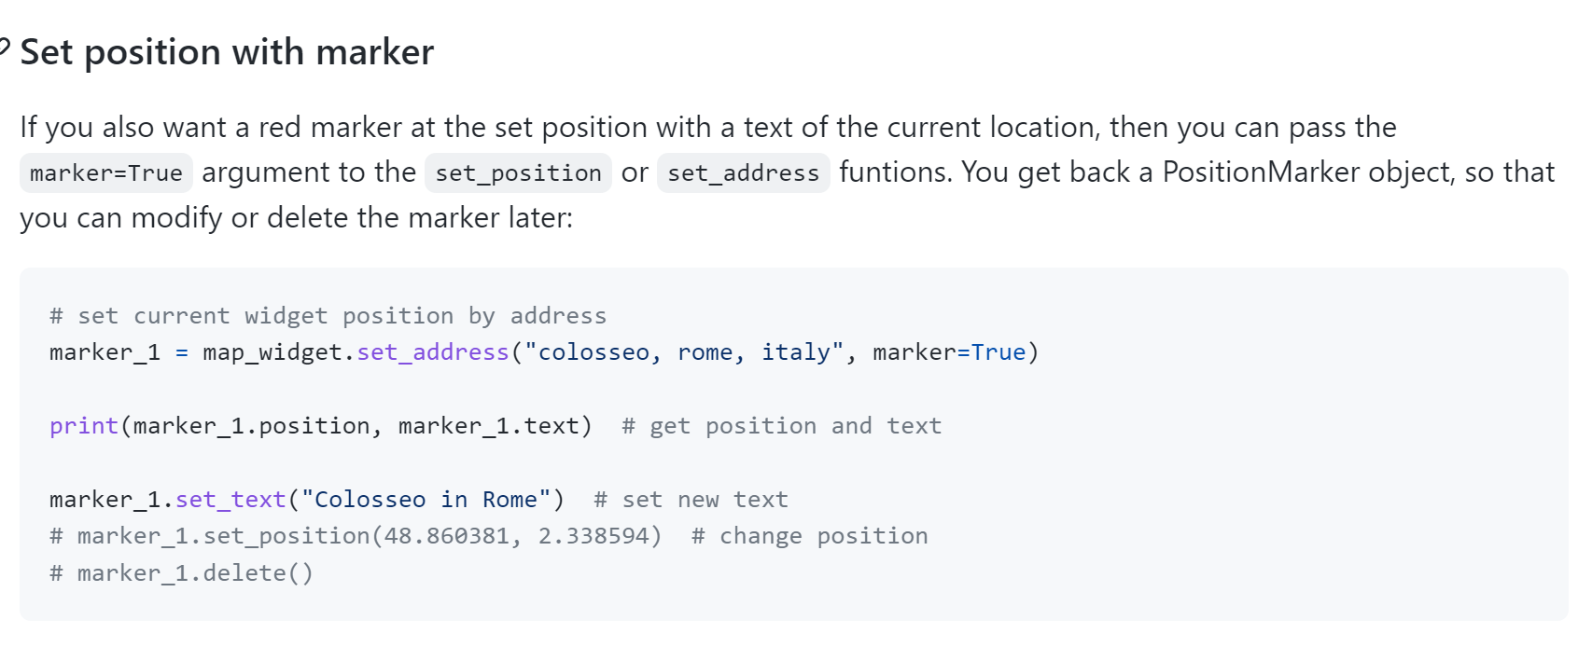
SOURCES/HELP

